Slide 1
Group:H3J
Leader:
Kotak Hiranj Maheshbhai
Team:
Keraliya Jay Ashvinbhai
Koladiya Hit Bharatbhai
Mendpara Henil Nileshbhai

Slide 2
01
02
Problem Statement
Idea and Approach
03
04
Use Cases
Technologies
05
Business Potential

Slide 3
PROBLEM STATEMENT
Creating a platform for
Encryption and Decryption of data using Steganography.

Slide 4
Idea and Approach
Data can be hidden in any image, audio, or video using the steganography technique. The primary goal of steganography is to conceal the path of communication between sender and receiver by encoding data in picture, audio, or video.
The goal of our project is to develop a website which can
Encrypt the data entered by user into image using Steganography.
We will also offer the ability to save encrypted images in
IPFS which is P2P (Peer-to-Peer) network model for file sharing that is decentralized and distributed across many computers or nodes. Files are broken down into different parts and stored across a network of nodes, that track the file by hashes. When the parts are assembled together, based on their hash value, it recreates the original file.

Slide 5
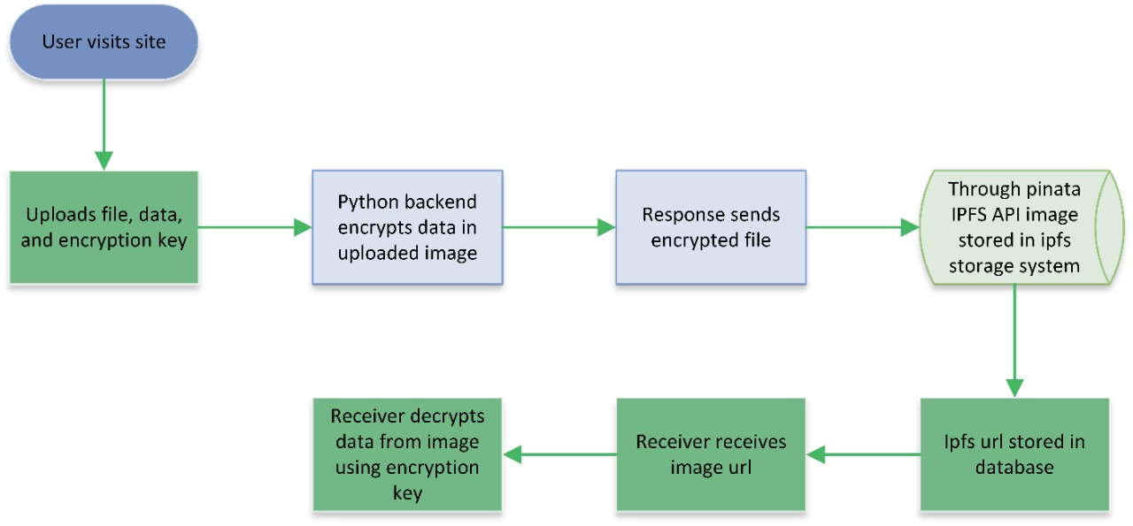

Slide 6
Use cases
SECURITY
COMPANY
This will help creating confidential channel between the sender and receiver
Steganography can be generally used to perform watermarking. Although the concept of watermarking is not certainly steganography. There are several steganographic approaches that are being utilized to save watermarks in data.
In current e-commerce transactions, some users are secured by a username and password, with no real approach of checking that the user is the actual card holder.
Biometric finger print browsing, connected with specific session IDs installed into the fingerprint images through steganography , etc.

Slide 7
Technologies
Programming language: HTML, CSS, JavaScript, Python,TypeScript
Backend : Flask
Storage: Pinata IPFS(InterPlanetary File System)
Image Processing : pillow
Frontend: Next.JS, Tailwind CSS

Slide 8
Business Potential
We can charge the user for encrypting data
As discussed in the use cases we can sell this model to government can use this model in biometric system
We can also sell this model to Army
As discussed in the uses We can sell this model to E-commerce,etc.

Slide 9
Thank You

